Slide 1

WELCOME TO OUR PRESENTATION

Slide 2
PRESENTED BY
RASHADA CHOWDHURY
UPOMA DHAR TONNNY

Slide 3

North East University, Bangladesh
Department of Computer Science
Project of
DATABASE SYSTEM

Slide 4
Project Title:
FROZENSCOOPS ONLINE ICE-CREAM SHOP

Slide 5
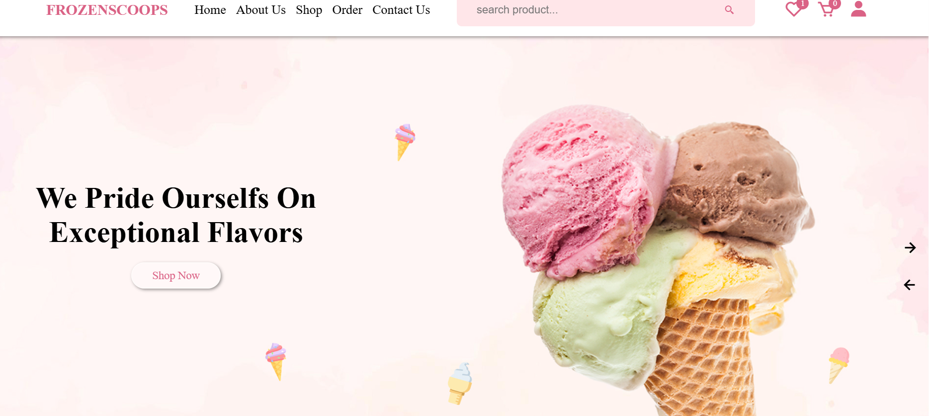

Slide 6
OVERVIEW
Frozenscoops offers a delightful array of premium ice cream flavors, delivered directly to your door. Enjoy a convenient shopping experience with our user-friendly website and exclusive online deals. making every order a celebration of sweetness. Treat yourself to the best ice cream without leaving home with Frozenscoops!
Convenience: Shop for your favorite ice cream flavors from the comfort of your home and have them delivered right to your door.
Variety: Choose from a wide range of flavors, including classic favorites and unique, artisanal options.
Quality: We ensure top-notch quality by partnering with renowned brands and local artisans.
Exclusive Deals: Enjoy special offers and discounts available only to our online customers.
User-Friendly Experience: Our website is easy to navigate, making your shopping experience smooth and enjoyable.
Frozenscoops combines convenience, variety, and quality to make your ice cream experience exceptional. Treat yourself today!

Slide 7
Technology Used:
Frontend: HTML,CSS,JAVASCRIPT
Backend: PHP
Database: MY SQL

Slide 8
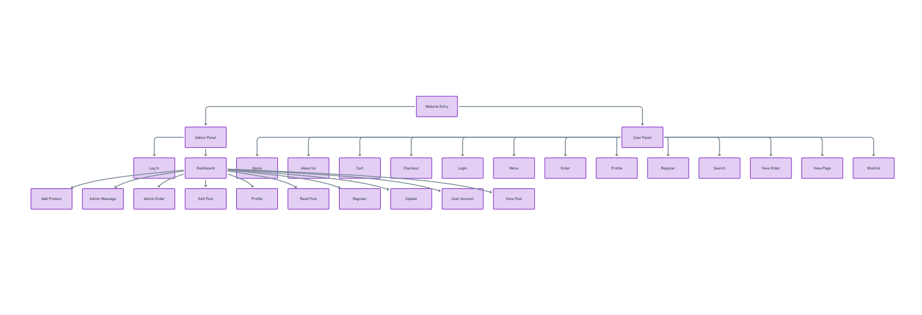
FLOWCHART

Slide 9
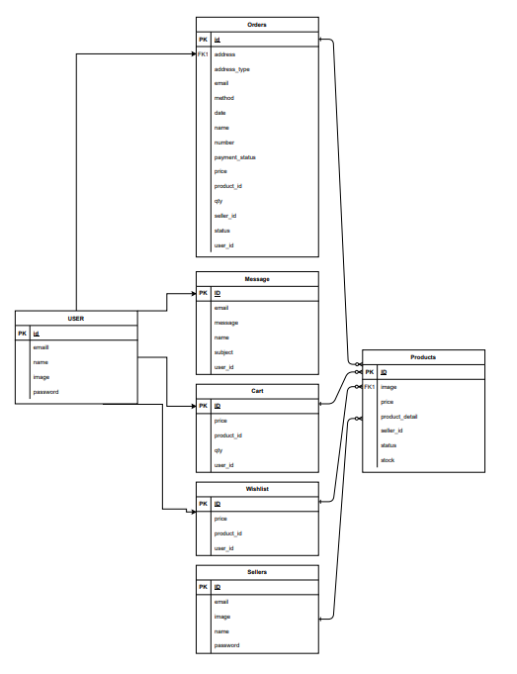
DATABASE DESIGN

Slide 10
FEATURES

Slide 11
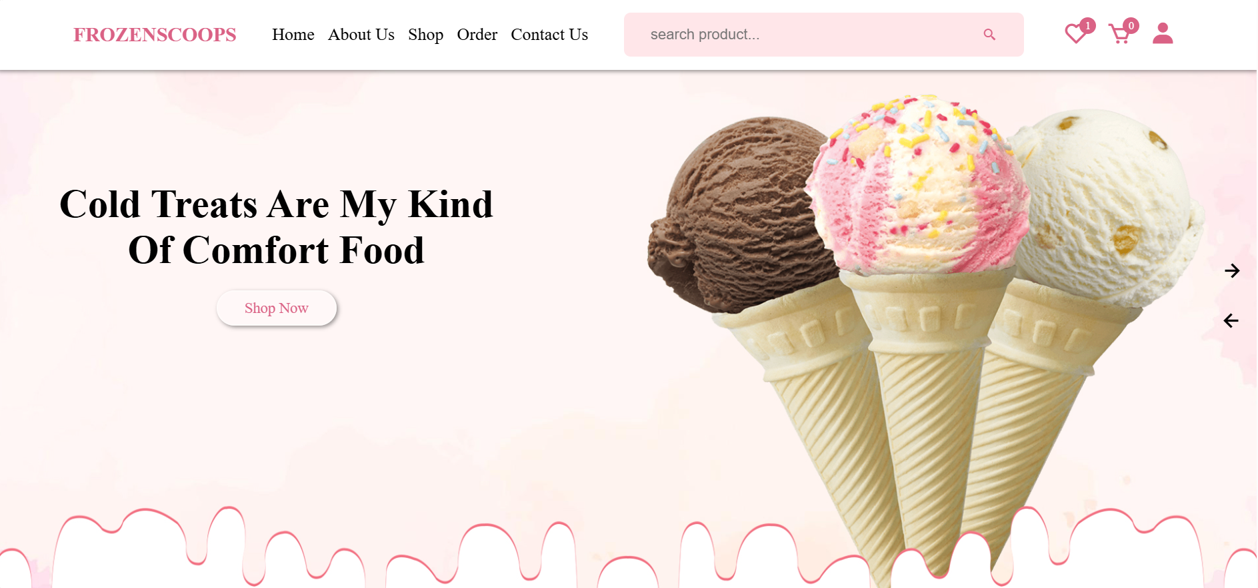
USER PANEL: HOME

Slide 12
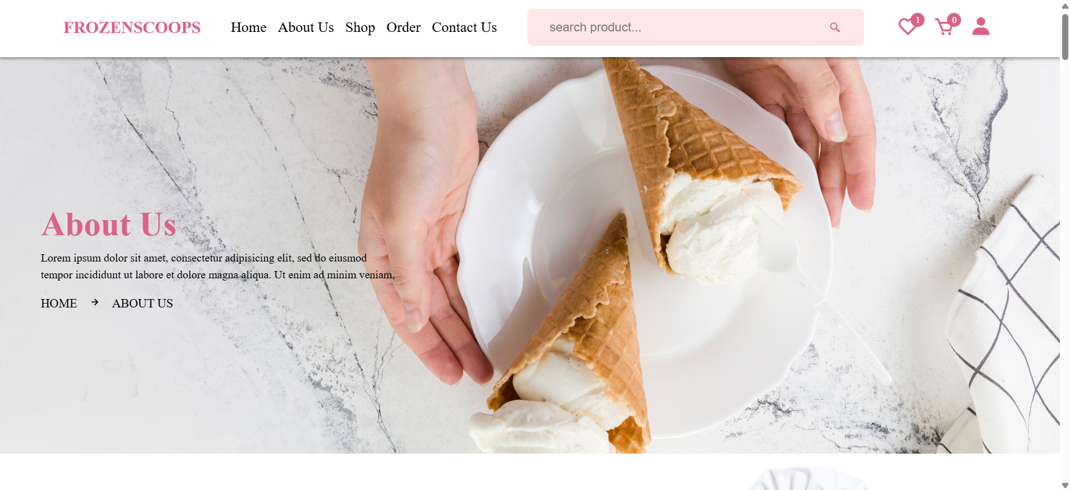
ABOUT US

Slide 13
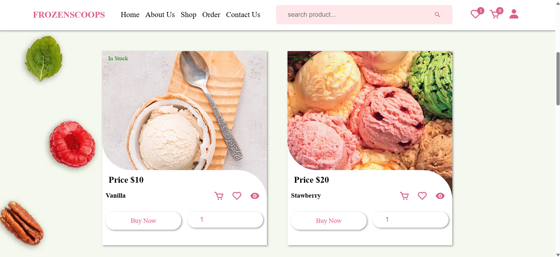
SHOP

Slide 14
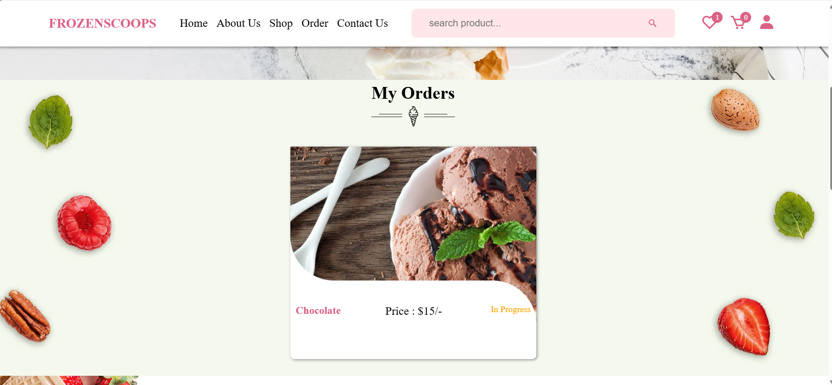
ORDER

Slide 15
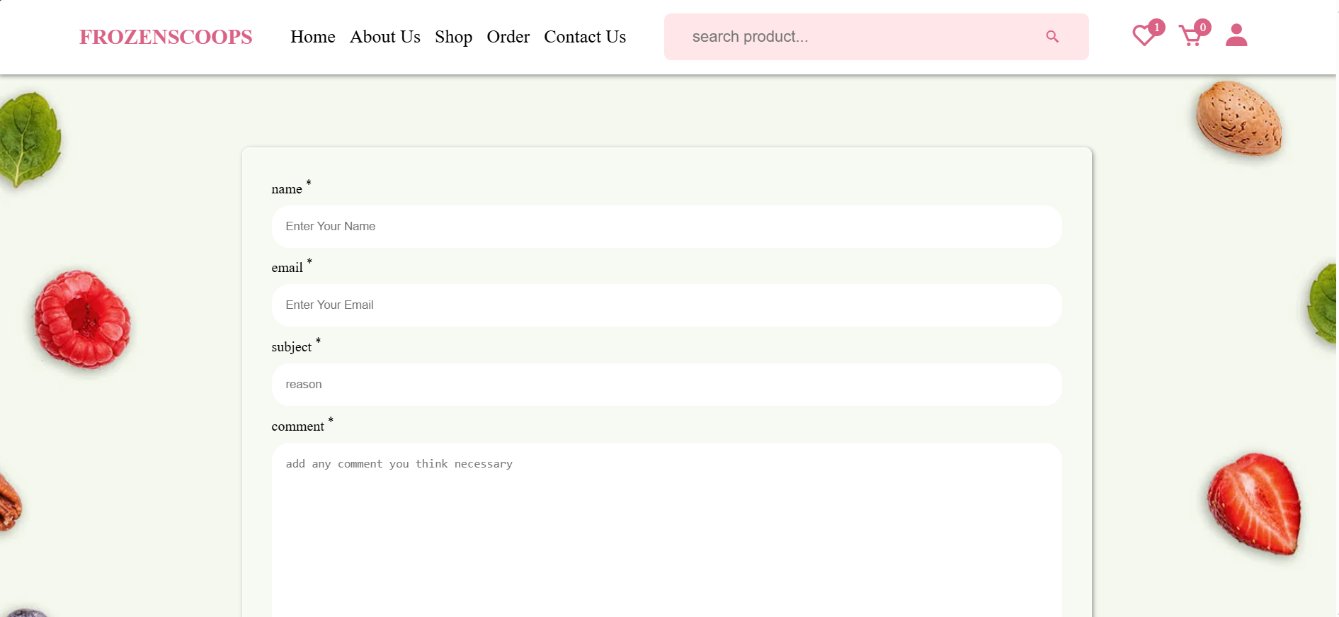
CONTACT US

Slide 16
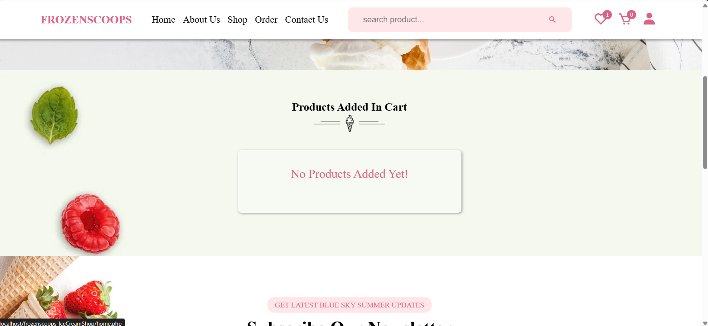
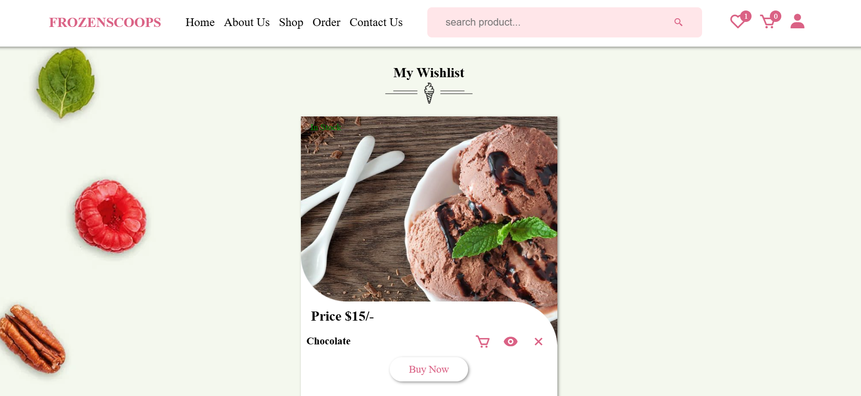
CART
WISHLIST

Slide 17
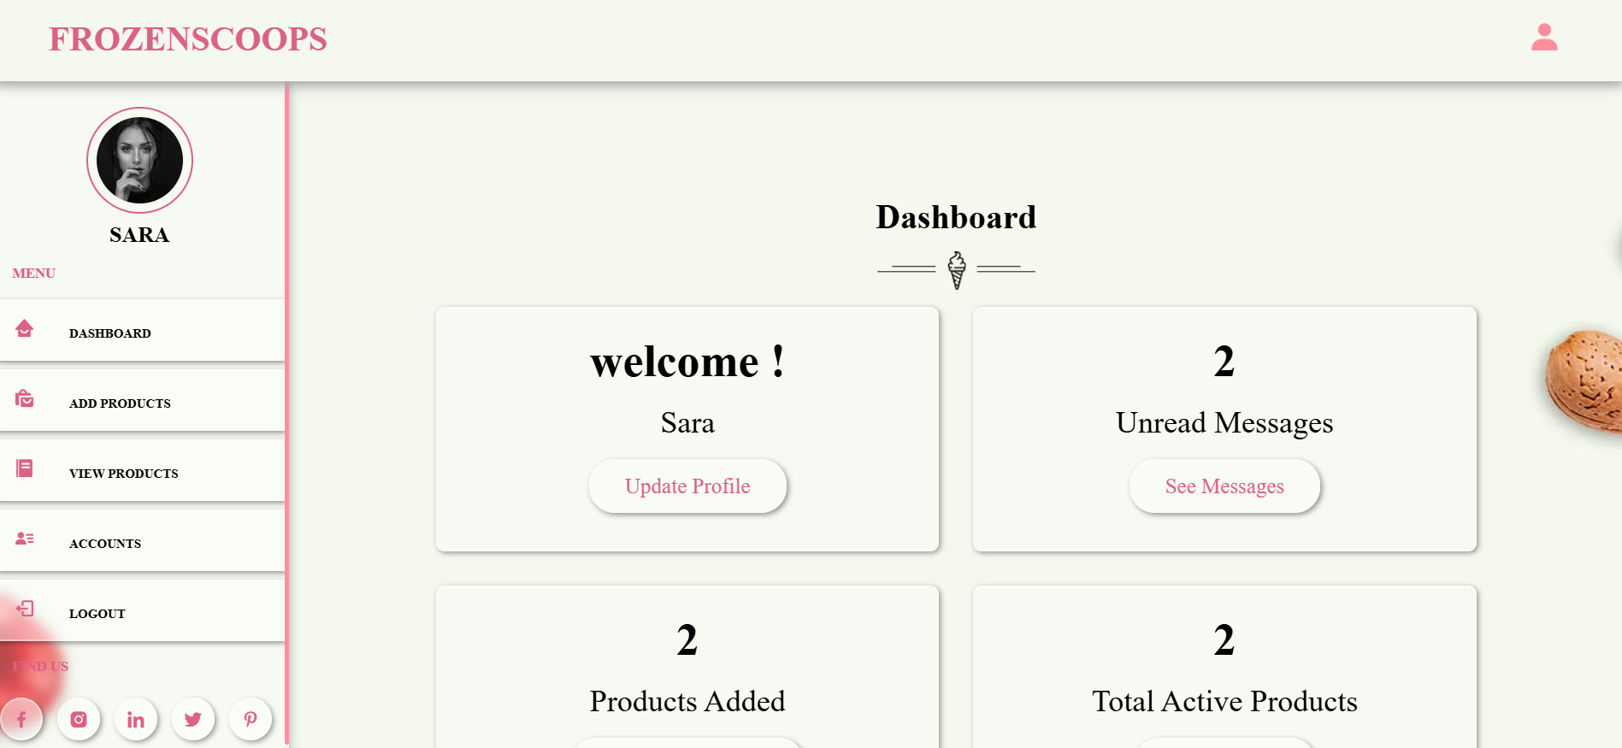
ADMIN PANEL: DASHBOARD

Slide 18
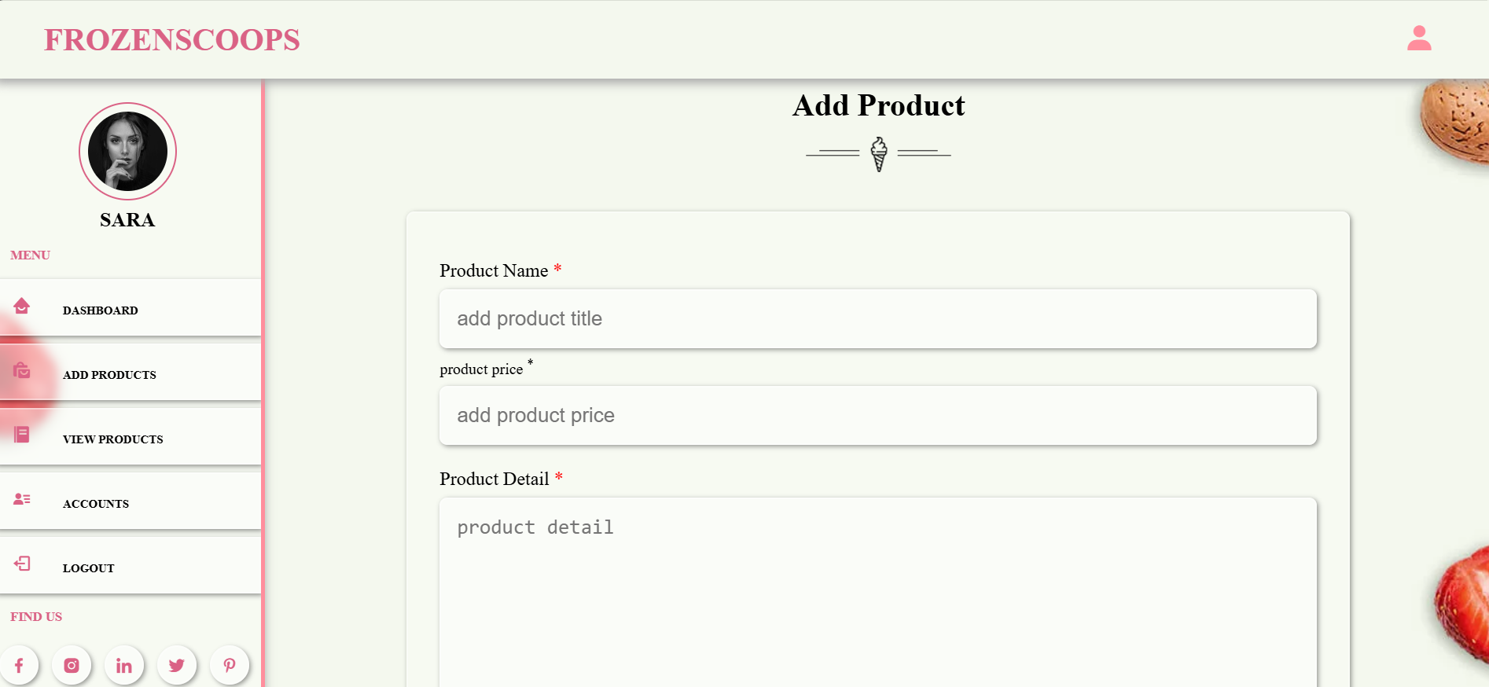
ADD PRODUCTS

Slide 19
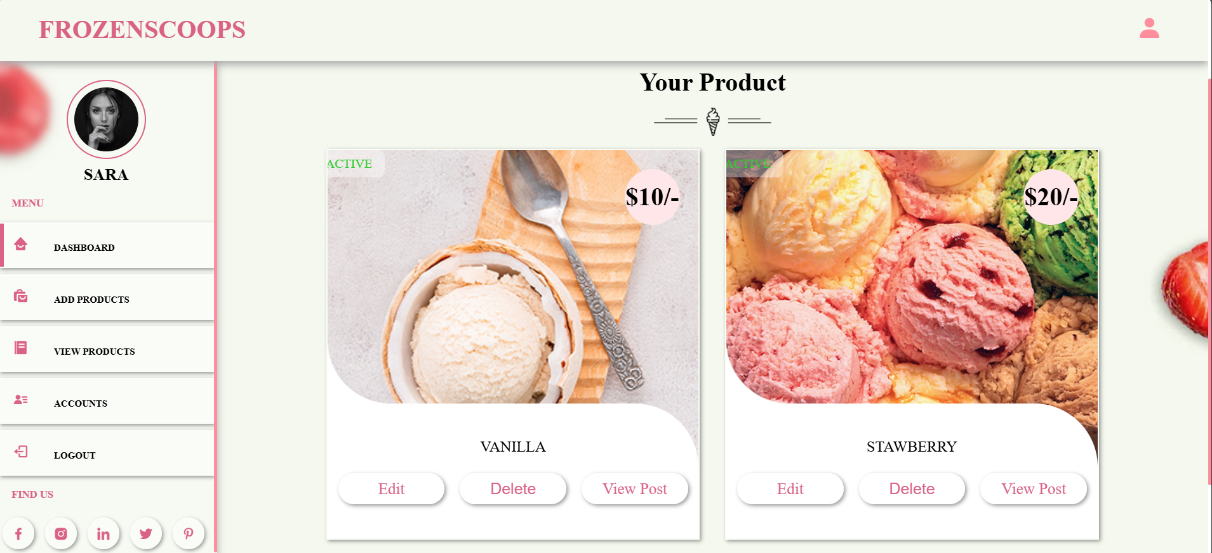
VIEW PRODUCTS

Slide 20
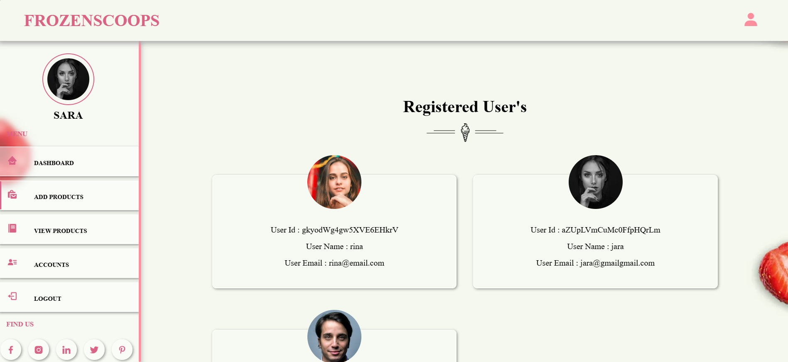
USER ACCOUNTS

Slide 21
The End

